Slide 1
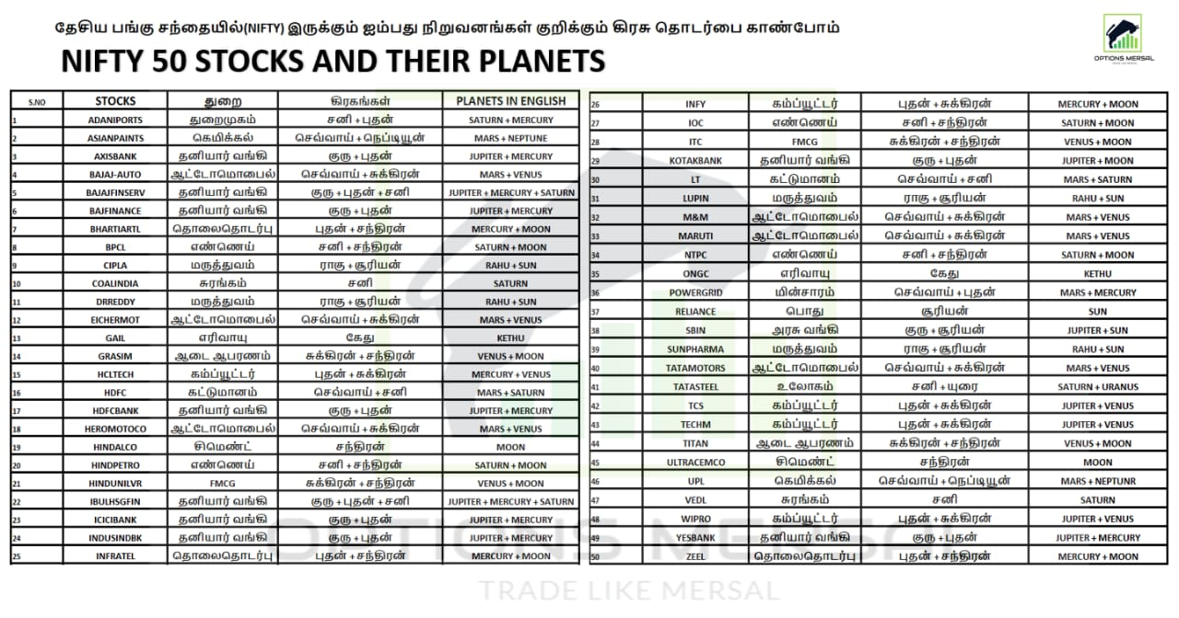

Slide 2
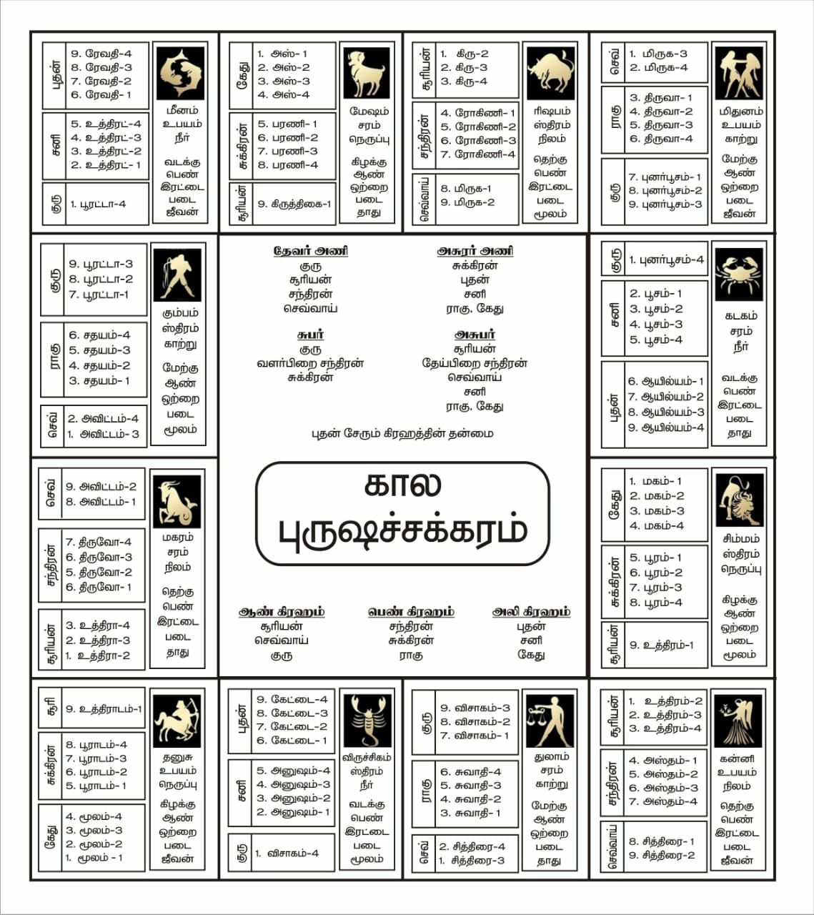


Slide 3
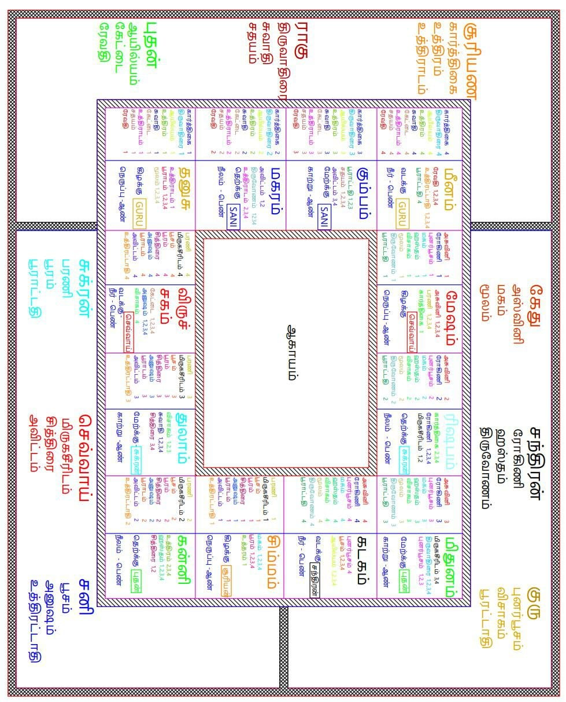

Slide 4
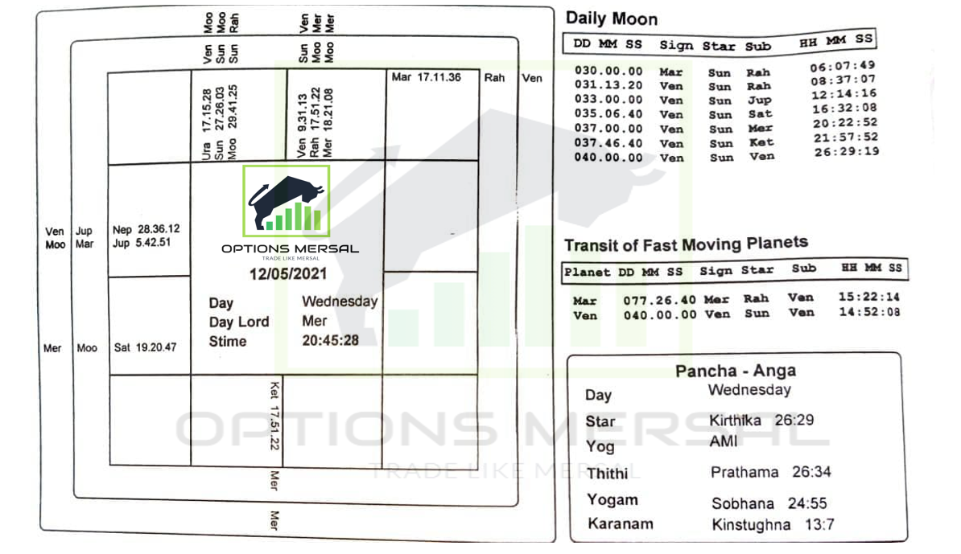
MOON 29* TO NEXT 29*-1 HOUSE

Slide 5
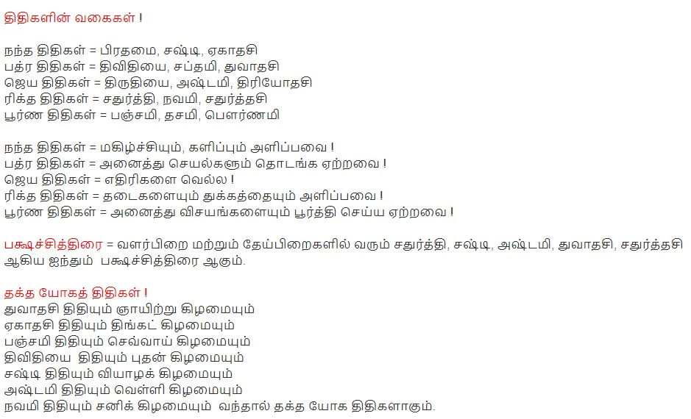

Slide 6
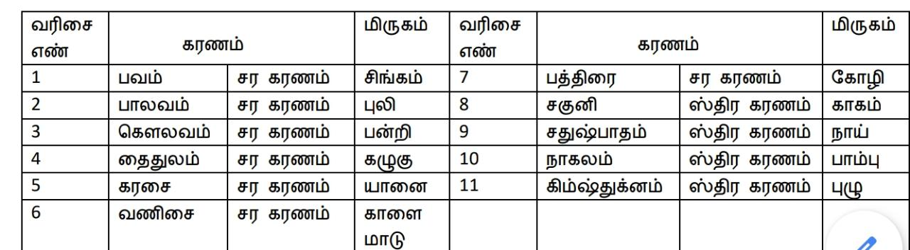

Slide 7
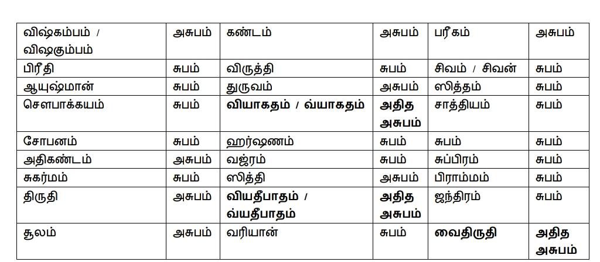

Slide 8
NATCHATHIRAM
KETHU -NEGATIVE
SATURN-NEGATIVE
VENUS-POSITIVE
MOON-POSITIVE
MERCURY-POSITIVE
JUPITER-CURRENT SITUATIONS
MARS -60%NEGATIVE
-40%POSITIVE
RAGHU-EVERYTHING HAPPEN BIG

Slide 9
MONDAY-MOON
TUESDAY-MARS
WEDNESDAY-MERCURY
THURSDAY-JUPITER
FRIDAY-VENUS
X OR Y(DAY LORD RULE)
X1 & Y1(NO DAY LORD RULE)

